Slide 1

DFS Lineup Optimizer January 18, 2018
Project Release Plan
[TBD Team name]
Team members:
Product owner: Gautam Sarkar
Initial scrum master: Joelle Steichen
Ben Sherriff
Nagie Khant
Joey Casteloes
Edmund Yu

Slide 2
DFS Lineup Optimizer
Project Release Plan
A lot of DFS Lineup Optimizers require users to pay and our DFS Lineup Optimizer provides a free desktop application alternative
High-Level Goals:
Be able to spit out optimized lineups
Be able to create lineup settings for all usual settings present in DFS Optimizers
Be able to create non-trivial settings based on my own insights
Be able to import my data without wrangling it to fit with the optimizer’s header columns
Be able to export my data easily inside the GUI tool
Have it available on all platforms

Slide 3
DFS Lineup Optimizer
Project Release Plan – User Stories
Sprint 1 user stories each labeled with assoc. high-level goal
As a new user I want an intuitive GUI so I don't have to spend time learning a new tool
As a person on the move, I want a non internet based tool so I can use it wherever I am
As a DFS player I want a ‘constraint’ for the number of players selected so I can output actual lineups
As a DFS player I want a ‘constraint’ for the sum of a column so I can limit the total cost of my team
As a DFS player I want a ‘constraint’ for the number of unique values(really strings) in each column so I can limit the number of players in each position/team
Sprint 2 user stories each labeled with assoc. high-level goal
As a DFS player I want a to choose the number of lineups outputted so I hedge/consolidate my risks
As a DFS player, I want an export to csv so all I don’t have to spend time manually doing it myself
As a DFS player I want savable configurations so I can easily use it multiple times
Sprint 3 user stories each labeled with assoc. high-level goal
As a DFS player I want a large amount of possible ‘constraints’(5+) so I can just plug in my data without modifying it and without
As a DFS player I want a ‘constraint’ for the number of times a certain row#(player) is selected so I can hedge/consolidate my risks
As a DFS player I want preloaded configurations for different sports/DFS providers so I can quickly modify and use the tool

Slide 4
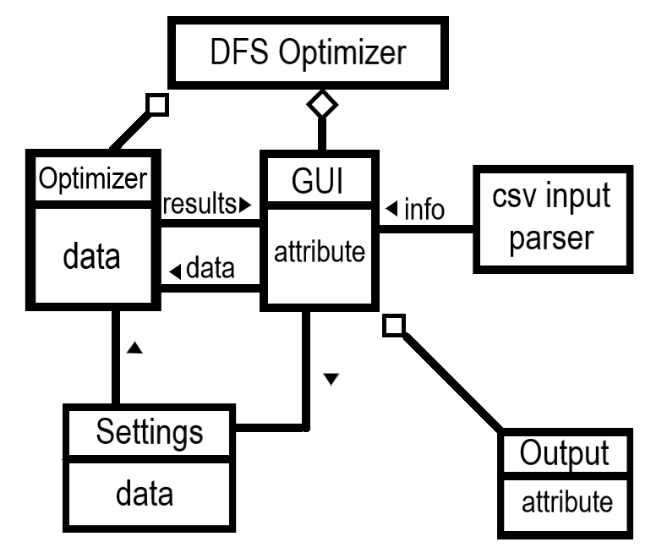
Project Release Plan – Architecture

Slide 5
DFS Lineup Optimizer
Project Release Plan – Challenges/Risks
Challenge/Risk 1 (complex feature set)
Have to figure out what Python library to use for GUI
For those who don’t know the language and/or framework, they will have to learn
Challenge/Risk 2 (unfamiliar technology)
Figure out how to pass information from GUI
Challenge/Risk 3 (unfamiliar technology)
Python not being on lab computers(use an executable?)
…

Slide 6
DFS Lineup Optimizer
Project Release Plan – Technologies
Technology 1 (programming language(s))
Python 3
Technology 2 (external libraries)
Pulp
Pandas
TBD Desktop Framework

